Slide 1
Web Science:
Intro to Python
(Part 1 - Overview and Basics)
CS 432/532
Old Dominion University
Permission has been granted to use these slides from Hany SalahEldeen, Sawood Alam, and Alexander Nwala, Michele C. Weigle
This work is licensed under a Creative Commons Attribution-NonCommercial-ShareAlike 3.0 Unported License

Slide 2
What is Python?
A free and open source programming language
Scripting language
Interpreted and Compiled
Cross-platform
Dynamically typed
Object-oriented (but not enforced)
White-spaces for block indentation (no {})
Integrates with other languages
Developed in 1980s

Slide 3
Why Python?
Fast development and prototyping
Easy to test
Rich standard library
Rich community contributed libraries and modules
Less boilerplate code
Easy to read and write

Slide 4
Differences with C/C++ Syntax
White spaces for block indentation, no {}
No {} for blocks
blocks begin with : (in the preceding line)
No type declarations needed
No ++, -- operators
Several differences in keywords
and, or instead of && , ||
No switch/case

Slide 5
Expression vs. Statement
Expression
Represents something
Python evaluates it
Results in a value
Examples:
"Hello" + " " + "World!"
(5*3)-1.4
Statement
Does something
Python executes it
Results in an action
Examples:
print("Hello World!")
import os
Rule of Thumb: If you can print it or assign it to a variable, it's an expression. If you can't, then it's a statement.

Slide 6
Accessing the Python Interpreter
Run locally on your own computer
download and install from Welcome to Python.org
Login to ODU-CS Linux server
ssh linux.cs.odu.edu
or, use PuTTY to login to linux.cs.odu.edu (see Dr. Zeil's CS 252 notes, "Logging In")
Google Colab Notebooks

Slide 7
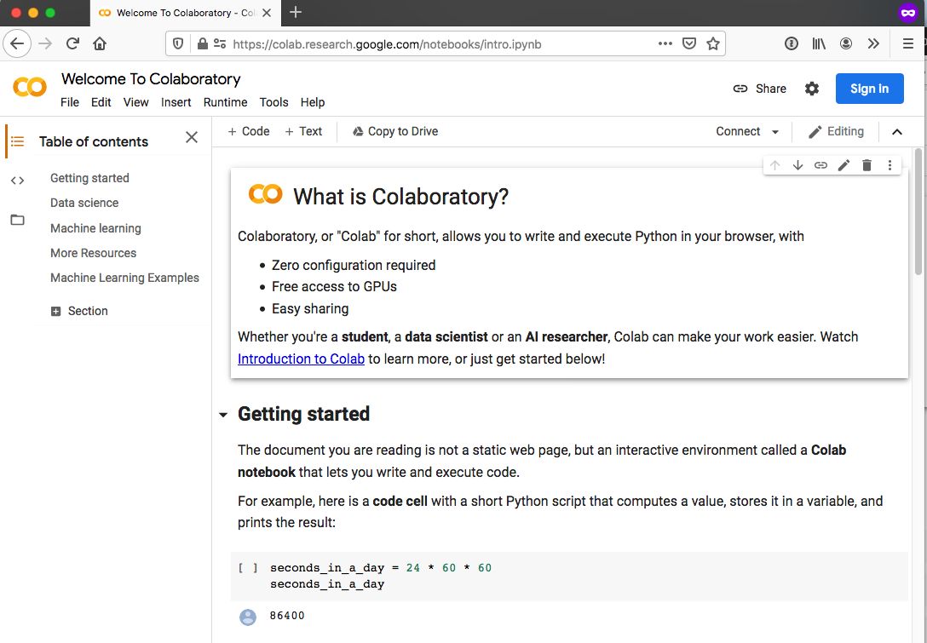
Google Colab Notebooks
Ref: Google Colab notebooks
Code examples for the rest of the slide set are also in a Google Colab notebook

Slide 8
Interactive Python Shell
$ python3
Python 3.6.9 (default, Apr 18 2020, 01:56:04)
[GCC 8.4.0] on linux
Type "help", "copyright", "credits" or "license" for more information.
>>> help(print)
Help on built-in function print in module builtins:
print(...)
print(value, ..., sep=' ', end='\n', file=sys.stdout, flush=False)
[...]
>>> print("Hello World!")
Hello World!
>>> 2 + 3 * 4 / 5
4.4
>>> exit
Use exit() or Ctrl-D (i.e. EOF) to exit
>>> exit()
$
On CS Linux machines, use python3 instead of python
Make sure you’re using Python 3, not Python 2

Slide 9
Simple Data Types
Integer: 7
Float: 87.23
Boolean: False, True
String: "abc", 'abc'
Bytes: b"abc", b'abc'

Slide 10
String vs. Bytes
Bytes object is a sequence of bytes
String is a sequence of characters that must be encoded (often in Unicode, UTF-8)
>>> type("Hello")
<class 'str'>
>>> type(b"Hello")
<class 'bytes'>
bytes and str instances can't be used together with operators like > and +
Ref: Strings, Unicode, and Bytes in Python 3: Everything You Always Wanted to Know

Slide 11
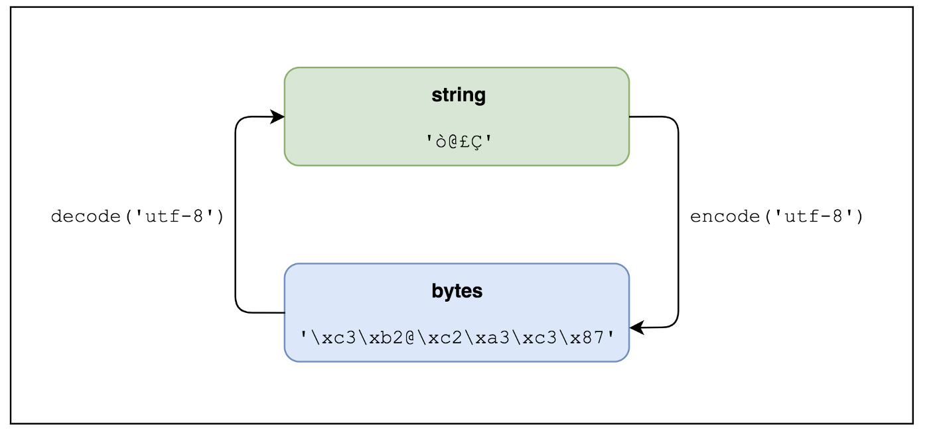
Decoding Bytes, Encoding Strings
>>> b"Hello".decode()
'Hello'
>>> "Hello".encode()
b'Hello'
Ref: Strings, Unicode, and Bytes in Python 3: Everything You Always Wanted to Know

Slide 12
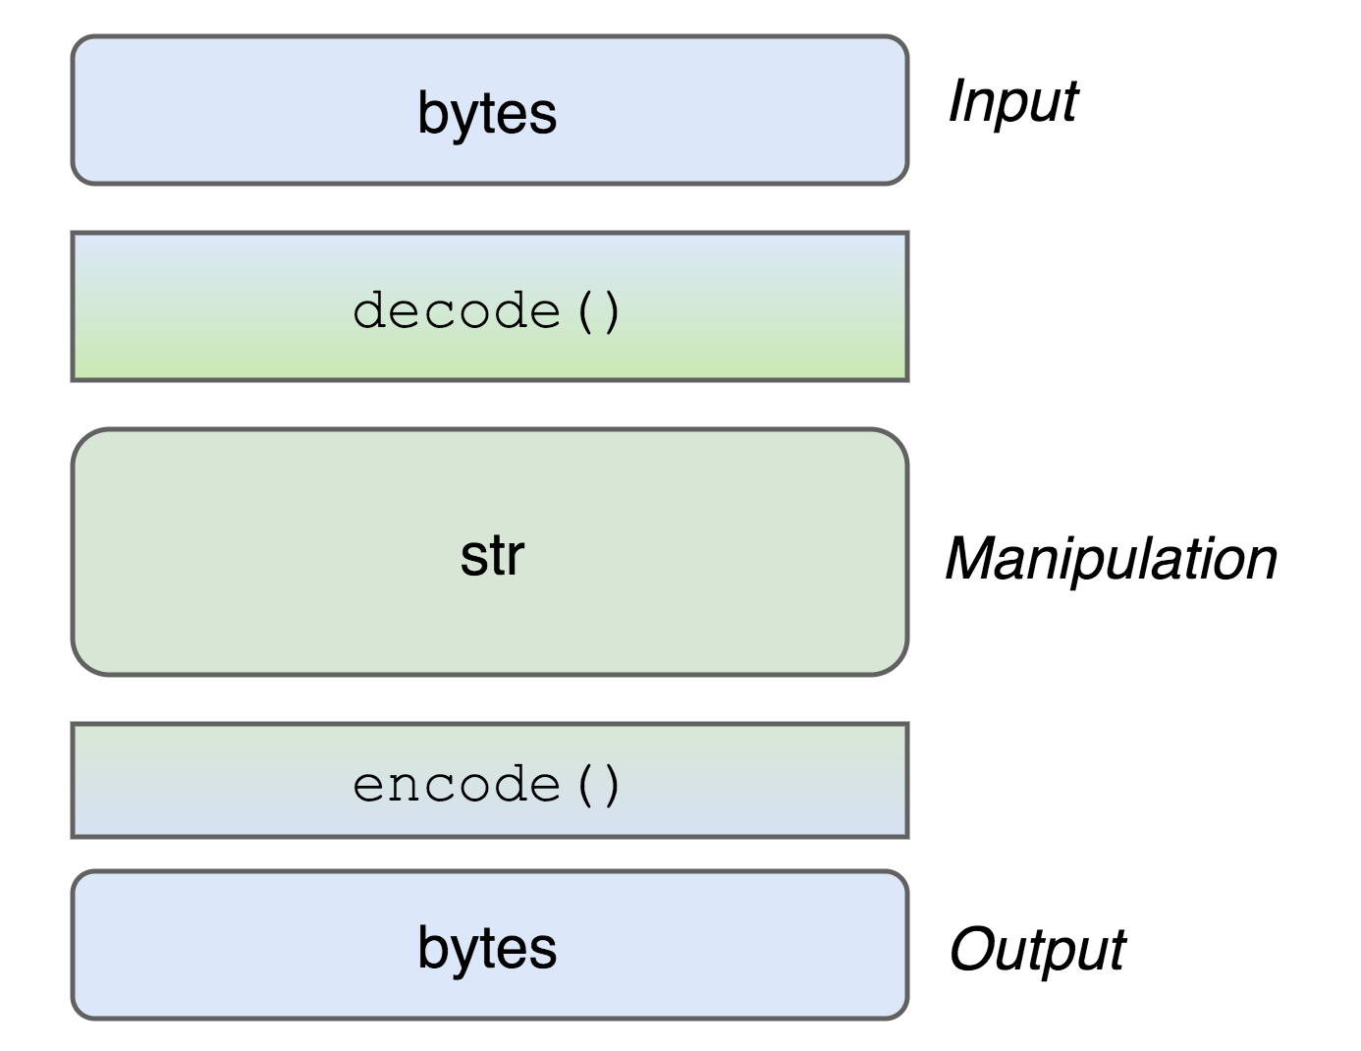
Manipulating Strings
"Unicode Sandwich"
"Bytes on the outside, unicode on the inside, encode/decode at the edges."
Ref: Strings, Unicode, and Bytes in Python 3: Everything You Always Wanted to Know

Slide 13
String
Concatenation: "Python"+"Rocks" → "PythonRocks"
Repetition: "Python" * 2 → "PythonPython"
Size: len("Python") → 6
Index: "Python"[2] → 't'
Slicing: "Python"[2:4] → "th" "Python"[:4] → "Pyth"
Search: "th" in "Python" → True
Comparison: "Python" < "ZOO" → True (lexicographically)

Slide 14
Compound Data Types
List: ["Hello", "There"]
Tuple: ("John", "Doe", 35)
Set: {"Python", "Ruby", "Perl"}
Dictionary: {"name": "John Doe", "age": 35}

Slide 15
List
Equivalent to arrays
X = [0, 1, 2, 3, 4]
Creates a pre-populated array of size 5
Y = []
Creates an empty list
X.append(5)
X becomes [0, 1, 2, 3, 4, 5]
len(X)
Returns the length of X, which is 6

Slide 16
List
>>> mylist.reverse() → Reverse elements in list
>>> mylist.append(x) → Add element to end of list
>>> mylist.sort() → Sort elements in list
ascending order
>>> mylist.index('a')→ Find first occurrence of 'a'
>>> mylist.pop() → Removes last element in list
Ref: Python documentation, "More on Lists"

Slide 17
List
>>> mylist = [0, 'a', "hello", 1, 2, ['b', 'c', 'd']]
>>> mylist [1]
a
>>> mylist[:2]
[0, 'a']
>>> mylist[3:]
[1, 2, ['b', 'c', 'd']]
>>> mylist [5][1]
c
>>> mylist.index("hello")
2
>>> mylist.remove('a')
>>> mylist
[0, "hello", 1, 2, ['b', 'c', 'd']]
>>> unsorted = [32, 18, 17, 2, 5]
>>> unsorted.sort()
>>> unsorted
[2, 5, 17, 18, 32]

Slide 18
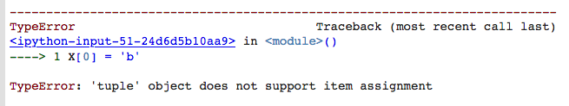
Tuple
>>> X = (0, 1, 'a', 4, 3)
Creates a pre-populated list of fixed size 5
>>> print(X[3])
4
>>> X[0] = 'b'
Lists vs. Tuples
Lists are mutable, tuples are immutable (can’t be changed)
Lists can be resized, tuples can't
Tuples can be faster than lists
Ref: Python documentation, "Tuples and Sequences"

Slide 19
Dictionary
An array indexed by strings (equivalent to hashes)
>>> marks = {"science": 90, "art": 25}
>>> print(marks["art"])
25
>>> marks["chemistry"] = 75
>>> print(marks.keys())
["science", "art", "chemistry"]

Slide 20
Dictionary
dict = { "fish": 12, "cat": 7}
'dog' in dict Is 'dog' a key?
dict.keys() Gets a list of all keys
dict.values() Gets a list of all values
dict.items() Gets a list of key-value tuples
dict["fish"] = 14 Assignment
Ref: Python documentation, "Dictionaries"

Slide 21
Variables
Everything is an object
Assignment = reference
No need to declare
No need to assign
Not strongly typed
>>> X = ['a', 'b', 'c']
>>> Y = X
>>> Y.append('d')
>>> print(X)
['a', 'b', 'c', 'd']
X
'a'
'b'
'c'
'd'
Y

Slide 22
Comments
# This creates and populates a list
mylist = [2,5,3,7,1,8,12,4]
# This prints out Hello World!
print("Hello World!")

Slide 23
Web Science:
Intro to Python
(Part 2 - I/O and Conditionals)
CS 432/532
Old Dominion University
Permission has been granted to use these slides from Hany SalahEldeen, Sawood Alam, and Alexander Nwala, Michele C. Weigle
This work is licensed under a Creative Commons Attribution-NonCommercial-ShareAlike 3.0 Unported License

Slide 24
User Input
Without a Message:
>>> x = input()
3
>>> x
'3'
With a Message:
>>> x = input('Enter the number: ')
Enter the number: 3
>>> x
'3'

Slide 25
Evaluate User Input
>>> x = input()
3+4
>>> x
'3+4'
>>> eval(x)
7

Slide 26
File Read
>>> f = open("input_file.txt", "r")
>>> line = f.readline()
>>> f.close()
File handle
Name of the file
Mode
Read one line at a time
Stop using this file and close
Ref: Python documentation, "Reading and Writing Files"

Slide 27
Manipulating Files
readline() - reads a line from file
readlines() - reads all the file as a list of lines
read() - reads all the file as one string

Slide 28
Loop Over a File Iterator
>>> f = open ("my_ file.txt", "r")
>>> for line in f:
print(line)

Slide 29
File Write
>>> f = open("output_file.txt", "w")
>>> f.write("Hello World!")
>>> f.close()
File handle
Name of the file
Mode
Write a string to the file
Stop using this file and close

Slide 30
Control Flow
Conditions:
if
if / else
if / elif / else
Loops:
while
for
for loop on iterators

Slide 31
Conditional
The condition must be terminated with a colon ":"
Scope of the loop is the following indented section
>>> if score == 100:
print("You scored a hundred!")
elif score > 80:
print("You are an awesome student!")
else:
print("Go and study!")

Slide 32
While Loop
>>> i = 0
>>> while i < 10:
print(i)
i = i + 1
Do not forget the : at the end of the condition!

Slide 33
For Loop
range(start=0, stop, step=1) - generates integer numbers between the given start and stop
>>> for i in range(10):
print(i)
>>> myList = ['hany','john','smith','aly','max']
>>> for name in myList:
print(name)
Do not forget the : at the end of the condition!
in - can be used in a loop to iterate through a list or in a conditional to test if a specific value is in a list
not in - can be used in a conditional to test if a specific value is not in a list

Slide 34
Inside vs. Outside Block
for i in range(3):
print("Iteration {}".format(i))
print("Done!")
Iteration 0
Done!
Iteration 1
Done!
Iteration 2
Done!
for i in range(3):
print("Iteration {}".format(i))
print("Done!")
Iteration 0
Iteration 1
Iteration 2
Done!
Note the print statement here. It uses {} to denote where the result should appear and the str.format() function to format the variable.

Slide 35
Pass Empty Block
It means do nothing
>>> if x > 80:
pass
else:
print("You are less than 80!")

Slide 36
Break the Loop
It means quit the loop
>>> myList = ['hany','john','smith','aly','max']
>>> for name in myList:
if name == "aly":
break
else:
print(name)
→This will print all names before “aly”

Slide 37
Continue to the Next Iteration
It means skip this iteration of the loop
>>> myList = ['hany','john','smith','aly','max']
>>> for name in myList:
if name == "aly":
continue
else:
print(name)
→This will print all names except "aly"

Slide 38
Web Science:
Intro to Python
(Part 3 - Functions and Modules)
CS 432/532
Old Dominion University
Permission has been granted to use these slides from Hany SalahEldeen, Sawood Alam, and Alexander Nwala, Michele C. Weigle
This work is licensed under a Creative Commons Attribution-NonCommercial-ShareAlike 3.0 Unported License

Slide 39
Find the Largest Number in a List
mylist = [2,5,3,7,1,8,12,4]
maxnum = 0
for num in mylist:
if (num>maxnum):
maxnum = num
print("The largest number is {}".format(maxnum))
Note the print statement here. It uses {} to denote where the result should appear and the str.format() function to format the variable.

Slide 40
Functions
What if the code is a bit more complicated and long?
What if the same logic is repeated?
Writing the code as one blob is bad!
Harder to read and comprehend
Harder to debug
Rigid
Non-reusable

Slide 41
Functions
def my_function(parameters):
do stuff
My main program
Give parameters
to work with….
Magic box
Return results

Slide 42
Back to the example...
mylist = [2,5,3,7,1,8,12,4]
maxnum = getMaxNumber(mylist)
print("The largest number is {}".format(maxnum))

Slide 43
Functions
Implement the function getMaxNumber as you wish
def getMaxNumber(list_x):
maxnum = 0
for num in list_x:
if (num > maxnum):
maxnum = num
return maxnum

Slide 44
Is Anything Wrong with getMaxNumber()?
>>> getMaxNumber([3, 7, 1])
7
>>> getMaxNumber([3, -7, 1])
3
>>> getMaxNumber([-3, -7, -1])
0
def getMaxNumber(list_x):
maxnum = 0
for num in list_x:
if (num > maxnum):
maxnum = num
return maxnum

Slide 45
New getMaxNumber()
def getMaxNumber(list_x):
maxnum = list_x[0]
for num in list_x:
if (num>maxnum):
maxnum = num
return maxnum
>>> getMaxNumber([-3, -7, -1])
-1
For this example, there turns out to already be a built-in function to find the largest number in a list (max). getMaxNumber isn’t really needed.

Slide 46
Functions
All arguments are passed by value
All variables are local unless specified as global
Functions in Python can have several arguments or None
Functions in Python can return several results or None

Slide 47
Functions Can Return Multiple Values
def getMaxNumberAndIndex(list_x):
maxnum = list_x[0]
index = -1
i = 0
for num in list_x:
if (num>maxnum):
maxnum = num
index = i
i = i + 1
return maxnum, index

Slide 48
Calling a Multi-Value Function
mylist = [2,5,3,7,1,8,12,4]
maxnum, idx = getMaxNumberAndIndex(mylist)
print("The largest number is {} and its index is {}" . format(maxnum, idx))
The largest number is 12 and its index is 6
Note the print statement here. Now we have two {} instances. The variables are separated by a comma in the str.format() function.

Slide 49
Modules
Python contains lots of modules with useful functions.
Use the import statement to access the functions available in a module
Ref: Python Module Index

Slide 50
Module Example
>>> import math
>>> x = math.sqrt(9.0)
Or
>>> from math import sqrt
>>> x = sqrt(9.0)
Or
>>> from math import sqrt as sq
>>> x = sq(25.0)

Slide 51
Web Science:
Intro to Python
(Part 4 - Running Python, Error Handling)
CS 432/532
Old Dominion University
Permission has been granted to use these slides from Hany SalahEldeen, Sawood Alam, and Alexander Nwala, Michele C. Weigle
This work is licensed under a Creative Commons Attribution-NonCommercial-ShareAlike 3.0 Unported License

Slide 52
Python Files
Python files end with .py
To execute a Python file named myprogram.py
$ python myprogram.py
On ODU-CS Linux machines, use python3 instead of python (use Python version 3, not version 2)
$ python3 myprogram.py
$ python --version
Python 2.7.17
$ python3 --version
Python 3.6.9
Remainder of the slides will assume we’re on ODU-CS Linux and will use python3

Slide 53
Python Scripts
Scripts can be run without using the python3 command
#!/usr/bin/python3
# myprogram.py
print ("Hello World!")
$ which python3
/usr/bin/python3
1
$ chmod a+x myprogram.py
$ ls -l myprogram.py
-rwxr-xr-x 1 mweigle proxy 58 Jun 4 11:21 myprogram.py*
2
3
$ ./myprogram.py
Hello World!

Slide 54
Command-Line Arguments
To access command line arguments:
import sys
The arguments are in sys.argv as a list
len(sys.argv) - returns the number of arguments
sys.argv[0] - holds the name of the script
$ ./testargs.py weigle 432 532
Ref: sys — System-specific parameters and functions — Python 3.8.5 documentation

Slide 55
Command-Line Arguments
#!/usr/bin/python3
# testargs.py
import sys
print ("{} is the name of the script." . format(sys.argv[0]))
print ("There are {} arguments: {}" . format(len(sys.argv), str(sys.argv)))
for ind, arg in enumerate(sys.argv):
print ("[{}]: {} {}".format(ind, arg, sys.argv[ind]))
$ ./testargs.py weigle 432 532
./testargs.py is the name of the script.
There are 4 arguments: ['./testargs.py', 'weigle', '432', '532']
[0]: ./testargs.py ./testargs.py
[1]: weigle weigle
[2]: 432 432
[3]: 532 532

Slide 56
Error Handling
What happens when you have an error?
>>> sum_grades = 300
>>> num_students = input()
>>> average = sum_grades / int(num_students)
What if the user entered 0?

Slide 57
Error Handling
What happens when you have an error?
>>> sum_grades = 300
>>> num_students = input()
0
>>> average = sum_grades / int(num_students)
ZeroDivisionError: division by zero

Slide 58
Exception Handling
try:
average = sum_grades / int(num_students)
except:
# This catches if something wrong happens
print("Something wrong happened, please check it!")
average = 0

Slide 59
Exception Handling
try:
average = sum_grades / int(num_students)
except ZeroDivisionError:
# This catches if a number was divided by zero
print("You tried to divide by zero!")
average = 0

Slide 60
Exception Handling
try:
num_students = input()
average = sum_grades / int(num_students)
except ZeroDivisionError:
# This catches if a number was divided by zero
print("You tried to divide by zero!")
average = 0
except IOError:
# This catches errors happening in the input process
print("Something went wrong with how you enter words")
average = 0

Slide 61
Automated Testing with doctest
# max_num.py
def getMaxNumber(list_x):
"""
Returns the maximum number from the supplied list
>>> getMaxNumber([4, 7, 2, 5])
7
>>> getMaxNumber([-3, 9, 2])
9
>>> getMaxNumber([-3, -7, -1])
-1
"""
maxnum = 0
for num in list_x:
if (num>maxnum):
maxnum = num
return maxnum
if __name__ == '__main__':
import doctest
doctest.testmod()
$ python3 max_num.py
***************************************************
File "max_num.py", line 8, in __main__.getMaxNumber
Failed example:
getMaxNumber([-3, -7, -1])
Expected:
-1
Got:
0
***************************************************
1 items had failures:
1 of 3 in __main__.getMaxNumber
***Test Failed*** 1 failures.
Ref: doctest — Test interactive Python examples — Python 3.8.5 documentation

Slide 62
Web Science:
Intro to Python
(Part 5 - Regular Expressions and Web Libraries)
CS 432/532
Old Dominion University
Permission has been granted to use these slides from Hany SalahEldeen, Sawood Alam, and Alexander Nwala, Michele C. Weigle
This work is licensed under a Creative Commons Attribution-NonCommercial-ShareAlike 3.0 Unported License

Slide 63
Regular Expressions
Access functions with import re
Describe the regular expression pattern with compile()
Apply the pattern starting at the beginning of a string with match()
[] specifies a character class, range of characters to match
[abc] matches any of the characters ‘a’, ‘b’, or ‘c’
[^abc] matches any character NOT ‘a’, ‘b’, or ‘c’
Shortcuts to particular classes
\d [0-9] \D [^0-9]
\s [ \t\n\r\f\v] (any whitespace) \S (non-whitespace)
\w [a-zA-Z0-9_] (any alphanumeric) \W (non-alphanumeric)
Ref: Regular Expression HOWTO — Python 3.8.5 documentation

Slide 64
Regular Expressions
To repeat patterns
* matches 0 or more times
+ matches 1 or more times
To specify position in the line
^ requires start of the line
$ requires end of the line
Divide matches into groups with ()
Ref: Regular Expression HOWTO — Python 3.8.5 documentation

Slide 65
Regular Expression Example
HEAD /foo HTTP/1.1
^([A-Z]+)\s+(\S+)\s+([A-Z0-9\/\.]+)$
^([A-Z]+) 1 or more capital letters at the beginning of line
\s+ 1 or more whitespace character
(\S+) 1 or more non-whitespace character
\s+ 1 or more whitespace character
([A-Z0-9\/\.]+)$ 1 or more letters, numbers, /, or . at the end of
the line

Slide 66
Regular Expressions
>>> import re
>>> req = "HEAD /foo HTTP/1.1"
>>> pattern = re.compile(r"^([A-Z]+)\s+(\S+)\s+([A-Z0-9\/\.]+)$")
>>> m = pattern.match(req)
>>> m.groups()
('HEAD', '/foo', 'HTTP/1.1')
match() returns None if no match is found
groups() returns a tuple containing all of the subgroups
Ref: Regular Expression HOWTO — Python 3.8.5 documentation
Online regex tester: https://regex101.com/

Slide 67
Python Libraries: requests
The de facto standard for making HTTP requests in Python
import(requests)
response = requests.get('http://example.com')
Response headers and body are all stored in response
Refs: Requests: HTTP for Humans™ — Requests 2.24.0 documentation
Python's Requests Library (Guide) – Real Python

Slide 68
requests: Response Headers
import requests
response = requests.get('http://example.com')
print ("Status Code: {}".format(response.status_code))
print ("URI: {}\n".format(response.url))
print ("Headers: {}\n".format(response.headers))
print ("Date: {}".format(response.headers['Date']))
print ("Content-Type: {}".format(response.headers['Content-Type']))
print ("Content-Length: {}".format(response.headers['Content-Length']))
Refs: Python's Requests Library (Guide) – Real Python
redirection: Requests documentation, "Redirection and History"

Slide 69
requests: Request Parameters
import requests
response = requests.get('http://google.com/search', params={'q': 'LSU'})
print ("URI requested: {}".format(response.request.url))
print ("Status Code: {}\n".format(response.status_code))
# split the string into a list, one line per element
lines = response.text.splitlines()
# use loop to only print first 5 lines of the response
for i in range(5):
print(lines[i])
Ref: Python's Requests Library (Guide) – Real Python

Slide 70
Beautiful Soup: HTML/XML Parser
from bs4 import BeautifulSoup
import requests
response = requests.get('http://google.com/search', params={'q': 'LSU'})
soup = BeautifulSoup(response.text)
for links in soup.find_all('a'):
print(links.get('href'))
Refs: Beautiful Soup Documentation — Beautiful Soup 4.9.0 documentation
Beautiful Soup 4 Python, PythonForBeginners

Slide 71
Objectives
Explain the differences between Python and C/C++ syntax.
Execute a simple Python on the ODU-CS Linux server and in a Google Colab notebook.
Describe the differences between a tuple, list, and dictionary.
Write a Python program that accepts command-line arguments.
Write a Python program that uses the requests library to access a webpage.
Write a Python program that uses the BeautifulSoup library to extract all of the links in a webpage.

